Slide 1

Notes:
<number>

Slide 2

So what’s this Arduino all about?
ylab maker space
October 12, 2017
The David Dunlap Observatory

Slide 3
Logistics
Ladies’ room on second floor
Men’s room in basement (or unisex)
KEEP IT CLEAN!
It’s all volunteers here in our space
Even the cleaning
Historic facility!
Owned and operated by Town of Richmond Hill
Thank you to everyone for letting ylab be here

Slide 4
Mottos/rules of maker spaces
What could possibly go wrong?
Don’t be on fire
If it’s on fire, put it out.
If “it” is a person, put it out first.
If it was on fire, don’t do that again.
Clean up after the fire.
If you hear “It’s OK, I signed the waiver”, run.
If you break it or yourself, own up to it.
… if only for others to learn from your mistake.
Other stupid doesn’t give you the right to stupid

Slide 5
Upcoming Events – ylab.ca
Thursday Jan 17 – Startup York at Turtle Jacks - 5-7PM
Thursday Jan 17: A. I. North – Hands-on Jupyter (3rd Thu)
Tuesday Jan 22: Open House – What’s Laser Cutting All About?
Mon-Tue Jan 28-29: 2D CAD + Laser Cutting Class
Mon Feb 11: Intro to Arduino
Thu Feb 21: A. I North – Python Idioms for Data Science
And more coming!

Slide 6
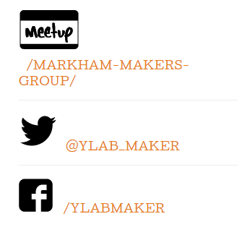
Social Media and Communications
We love feedback!
Pay attention to registration info - we use Eventbrite for the hands-on classes
Tonight: #ylabarduino
No more email list
http://ylab.ca

Slide 7
DISCLAIMER
We may not know what we’re doing.
Consult an expert first.
Don’t try any of this at home.
Electricity kills people and damages things.
Sharp objects and tools kill people and damage things.
We don’t let you touch anything at ylab if you have not signed a waiver

Slide 8
REMEMBER THIS
POWER = Voltage¹ x Current
Units: Watts = Volts x Amps
Formula²: P = V x I
You will be quizzed on this.
This will be on the test
Note 1: We’re supposed to say “Potential” or “Electromotive Potential”
Note 2: We’re supposed to say P = E x I

Slide 9
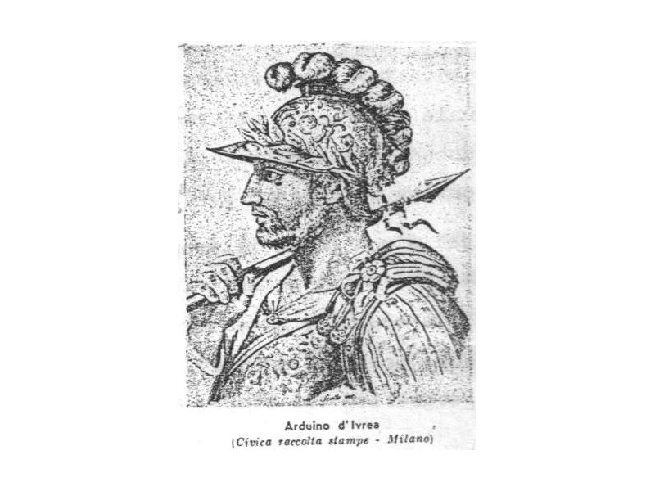
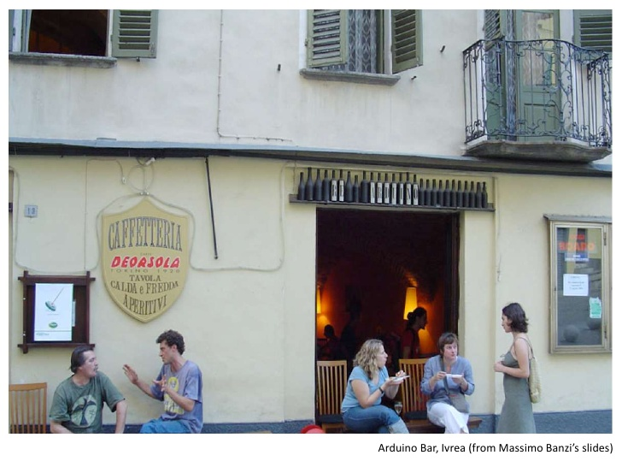
Arduino?
By Marilynmerlo - Own work, CC BY-SA 3.0, https://commons.wikimedia.org/w/index.php?curid=18536693

Slide 10
Arduino???
Name of the bar where the inventors met
Ivrea, Italy – home of Interaction Design Inst. (IDII)
Arduin of Ivrea, a.k.a. Arduino.
Excommunicated in 994. Some little murder thing.
King of Italy from 1002 to 1004
Germans and others in Italy disagreed.
Backed another king. Battle. Arduino lost.
They burnt his town.
After much vengeance, retired to monastery at Fruttuaria
Hmmm. 1000 years later, still Arduino battles and fruity tech

Slide 11

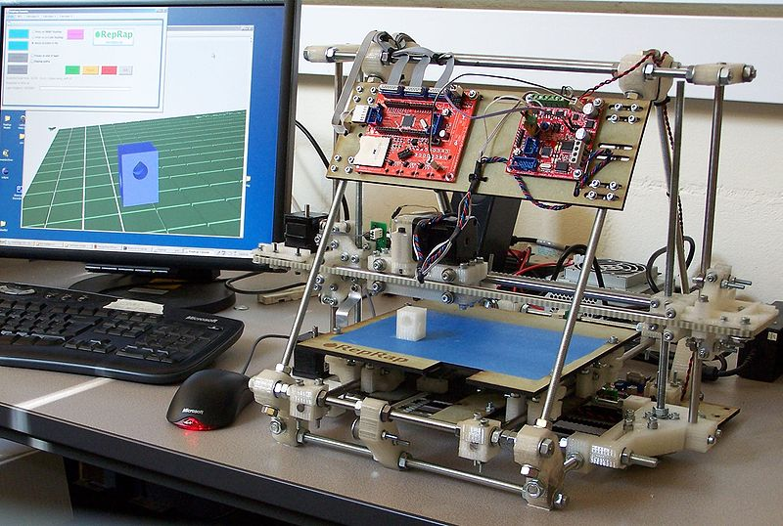

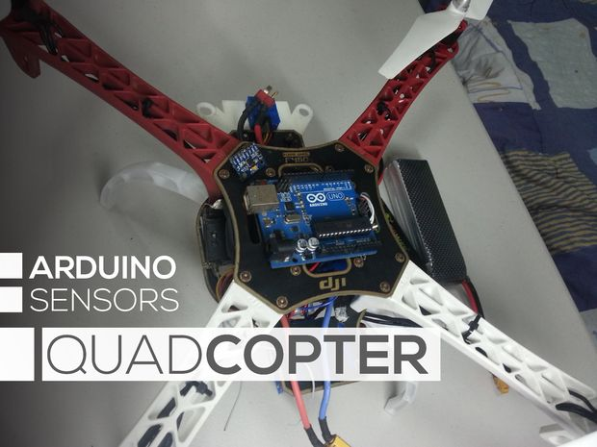

Slide 12
Why Arduino?
What if you want to control something that’s in the real world?
Computers:
Binary: ones and zeros
Real world has range of analog values
Really, really low power levels
Real world has 5V, 12V, 120V, 240V…
It talks to keyboards, drives etc - but how does that magic happen?
Microcontrollers: digital <-> real world

Slide 13
Arduino history
Open source: combination of efforts and timing
Wiring project at IDII to simplify coding for microcontrollers
Cheaper controller available
Supervisors designed cheaper board, and open sourced it so others could copy
Key design element: expansion!
Company formed to build boards
By 2013: estimated > 700,000 boards

Slide 14
Three worlds to bridge
Digital computers (software, memory)
Low voltage, very low power
Ones and zeros
Simple electronics
3.3 V, 5 V, but very low power
Power = V x I.
Rest of the world
5V, 12V, 120 V, 240V
Even at low V, more than board/USB can provide
Yes, you can damage your board

Slide 15
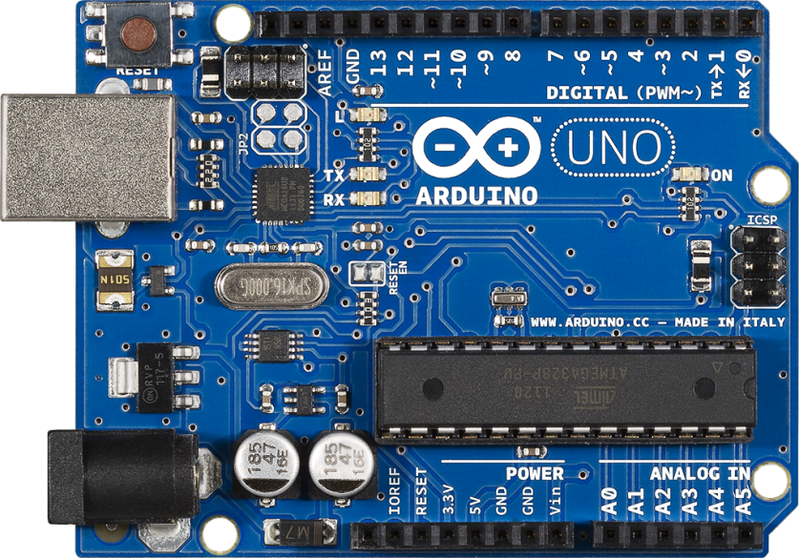
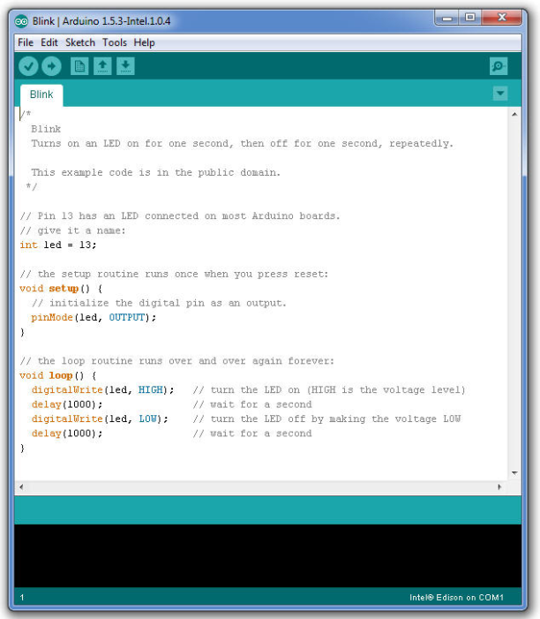

What Makes Arduino a Success
Open IDE
Open Hardware
Community
Google is your friend

Slide 16
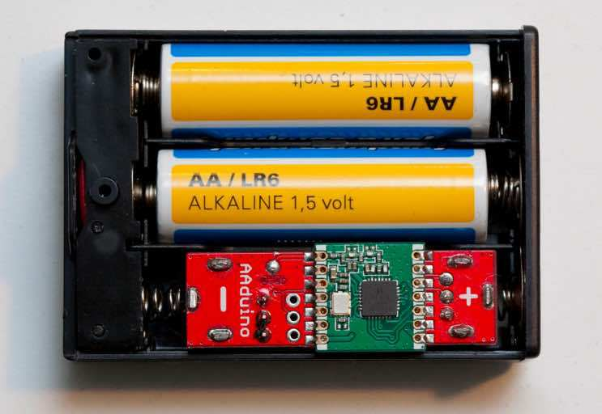
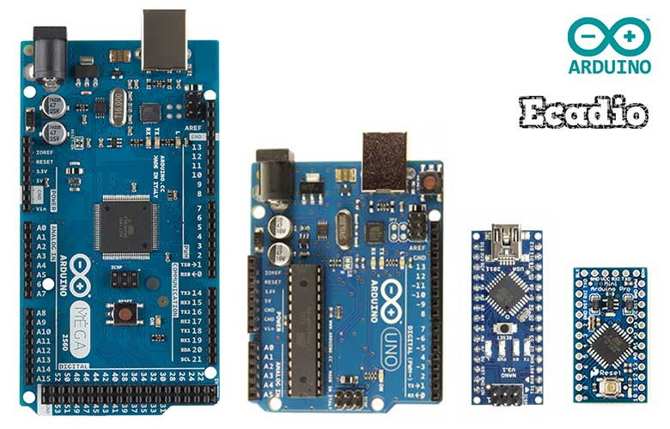
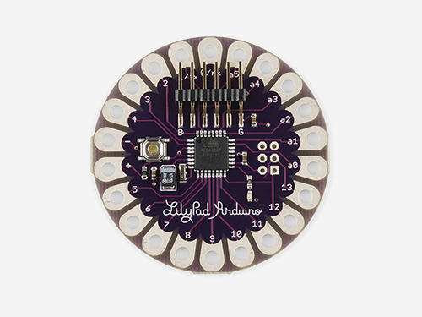
Formats

Slide 17
Four technical elements
Inputs
To read what’s going on in the real world
Outputs
To tell the real world what we want to do
Microcontroller
To run programs that talk with the I/O
Computer interface
To load programs, read/write what’s happening

Slide 18
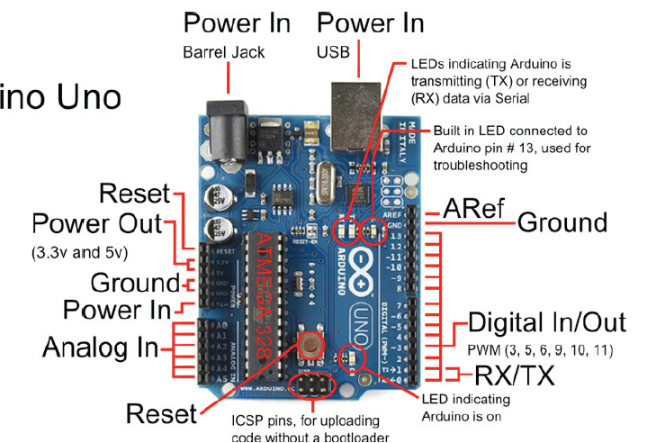
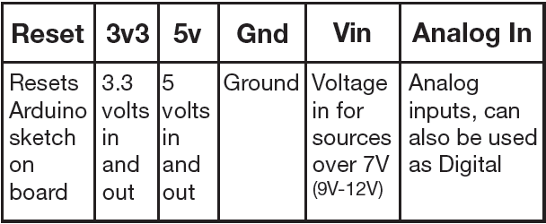
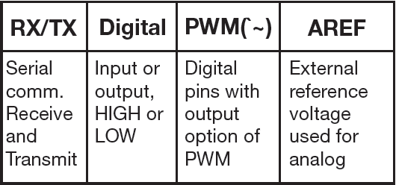
Arduino Uno
The one to start with
Pins make standard shield interface

Slide 19
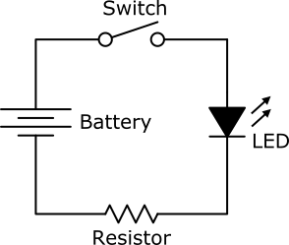
The new way: software rules
LED + resistor
Switch
Sensor
MICRO
CONTROLLER
MICROCONTROLLER
Read the inputs
Use software logic to decided what to do based on inputs
Send actions to outputs
Repeat
OLD SCHOOL:
Switch is directly in the circuit and controls

Slide 20
Reading the real world: sensors
Arduino input:
Analog: 0 to 5 V, in 1024 levels (0-1023, 10 bits)
Digital: Off or on
Sensors translate real world to these levels!
Simple on-off switch
Light
Temperature
Voltage

Slide 21
Sending to the real world
Output 0-5V in 256 levels (0-255, 8 bit)
Actuators
Directly-connected devices
LEDs, very simple electronics
Switches/relays
To Arduino, looks like simple, low power LED
Controls separate power supply to device(s)
Motors
Regular
Stepper
Solenoid

Slide 22
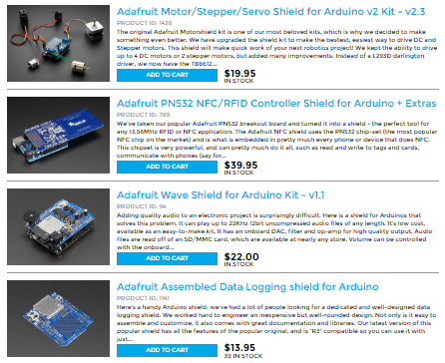

Shields
Better yet:
Take apart an old VCR
Buy a crimper/stripper and some terminators

Slide 23
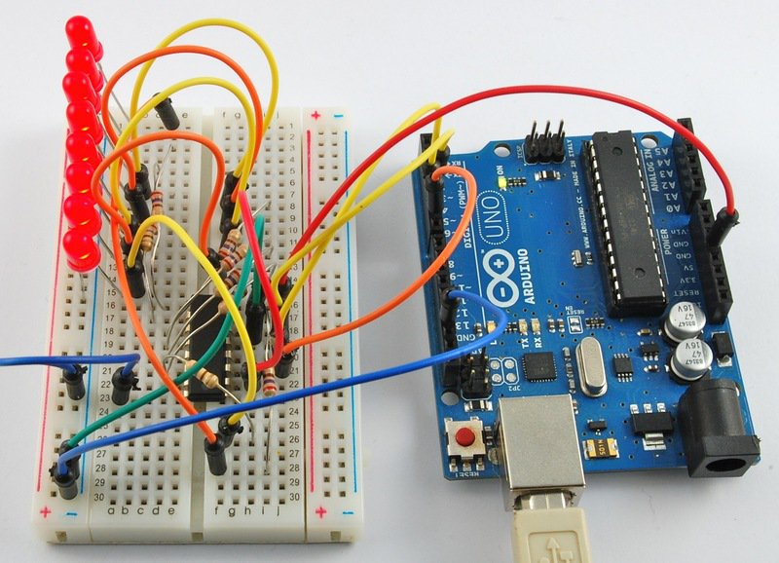

Slide 24
IDE: how we control it all
Arduino Sketches
Integrated Development environment
C–like programming language

Slide 25
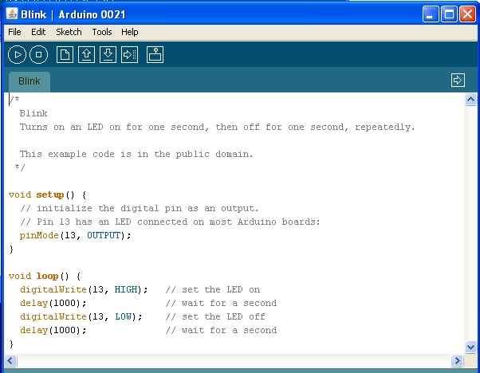

Slide 26

PC connection… or not
Write, download, test
Run tethered; communicate/commands
Standalone operation
Keeps running after code downloaded
“Reset” just restarts downloaded code

Slide 27
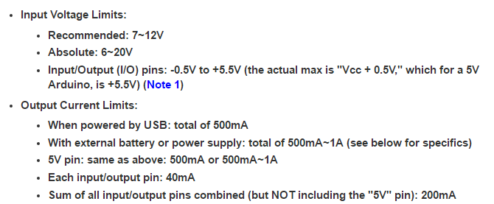
How much power can we handle?
Always calculate POWER (Watts) = Volts X Amps

Slide 28
Control and power now separate
Power and logic are separate
Old school: switch integral part of circuit
Digital control:
Software reads inputs
Software runs logic to make decisions
Software sends data/signals to outputs
Control uses minute voltages/currents
Minute voltages control high power
Relays; solid-state (transistors, thyristors…)
High power fed separately

Slide 29
Top ways to blow an Arduino
Connecting more than 6 volts to the 5V pin. (The two ATmega chips used on most Arduino boards have an absolute max of 6V.)
Connecting more than VCC (typically 5 volts) to any of the I/O pins.
Not current limiting the I/O pins to less than 40mA. (E.g. driving a motor directly or not using a current limiting resistor with a LED)
Connecting less than 5 volts to GND and GND to Vin or 5V (reversed power). Vin and Barrel jack do have a protection diode, but it isn't always enough.
Connecting a 5 volt supply to the 5V pin while connected to USB.
Changing connections while powered -- never do this!
JUST TOUCHING THE THING WITHOUT TOUCHING METAL, ANTI-STATIC STRAP, GROUNDING, ETC.
If worried… buy a Ruggeduino

Slide 30
Unusual ways to blow up Arduino
Attach it to a model rocket or fireworks
Put it in a pool
Hit it with a sledgehammer
Throw it off a cliff
Light it on fire (assuming you douse it in gasoline first)
Hook it up to AC mains
Put it out in the rain with a huge metal pole that will attract lightning and get it wet
DISCLAIMER: Don’t do anything on this list. Ever.

Slide 31
Going beyond Arduino
Make a circuit board: Fritz project
Go custom for volume, power, capabilities
Ylab light saber board:
All switches, sensors, etc in one compact piece
ARM Cortex/low power, heat for life inside hilt
Voltage control with low power/heat
Dual-channel audio for sound overlay
3-dimension accelerometers
Mini-SD for sound files

Slide 32
FINAL TEST
Power = ?
Watts = ?

Slide 33
Examples

Slide 34
Questions

Slide 35
Demos and visit
Have fun!
Ross?
Visit the space!
Ask questions!
Get out at 9:30
Because we have to clean up

Slide 36

http://ylab.ca
Notes:
<number>

